Slide 1


Entity Relationship Modelling

Slide 2
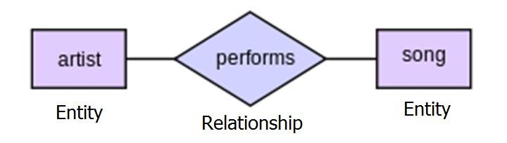
Entity Relationship(ER) Diagram
We will learn to develop ER Diagram in this topic.

Slide 3
Entity
An entity can be defined as anything, which can be uniquely identified and about which data is stored in a database.
A place, person, picture, concept (e.g. course, position, job) are the example of an entity.
Some other examples can be student, workers, car, departments, etc.

Slide 4
Entity Type
An entity type is a collection of similar entities.
An entity-type is a category.
An entity type is a group of objects, people, concepts or other items that have the same set of properties or attributes.

Slide 5
Entity Relationship(ER) Modelling
In 1976, Peter Chen first proposed modeling databases using a graphical technique that humans can relate easily.
An Entity–Relationship (ER) model is an abstract or conceptual way of describing a database
An ER Model is based on a perception of a real world that consists of collection of basic objects called entities and relationships among these objects.

Slide 6
Entity Relationship(ER) Modelling
The ER model achieves a high degree of data independence which means that the database designer do not have to worry about the physical structure of the database.
The goal of ER Modelling is to produce a model of data that is non-
technical and free of ambiguities

Slide 7

Entity Relationship(ER) Diagram
ER diagram is a graphical modelling to standardize ER modelling.
The modeling can be carried out with the help of pictorial representation of entities, attributes, and relationships.

Slide 8
Attributes
An attribute is a property of an entity type.
The data that we want to keep about each entity within an entity type is contained in attributes.
Examples of Attributes :
Roll number, name and grade are the attributes of Student.
Brand, cost and weight are the attributes of Cellphone.
Book name, price, author, publisher, etc. are attributes of Book.

Slide 9
Types of Attributes
Single-valued attribute
Multi-valued attribute
Null Attribute
Simple Attribute
Composite Attribute
Key Attribute
Derived Attribute
Attribute Domain

Slide 10
Types of Attributes
1. Single-valued attribute :
Attribute that holds a single value for an occurrence of an entity type.
E.g. age, first_name, last_name, full_name, etc.
Multi-valued attribute :
Attribute where there might be more than one value for a given occurrence of an entity type, e.g. for the 'Telephone Number', where a person or company might have many of these.
Null attribute : Attribute that has NULL.

Slide 11
Types of Attributes
Simple Attribute
It is composed of a single component. e.g. age, first_name, last_name, etc. But full_name is not simple attribute. Because it is composed of first_name and last_name.
Composite Attribute
It is composed of more than one component. For example, 'address' might have city, state, country, zip code, etc.

Slide 12
Types of Attributes
Key Attribute
Primary Key is a key attribute.
Not Null and Unique attribute of an entity
At most one attribute in each entity
Derived Attribute
The value of the derived attribute can be derived from the values of other attributes
Age of a person can be derived from the date of birth and current
date i.e. age = current date – date of birth.

Slide 13
Types of Attributes
Attribute Domain
A domain is the set of allowable values for an attribute or number of attributes.
A domain therefore limits the values that an attribute can have.
For example, the domain of 'gender' would include the values 'Male' and 'Female'.
Similarly, the domain of fruit would include the values 'Apple', 'Orange' etc.

Slide 14
Relationship
A relationship is an association of entities showing how the entities are related with each other.
The examples of relationship are:
Teaching is the relationship between Lecturer and Student.
Buying is the relationship between Vendor and Customer.
Treatment is the relationship between Doctor and Patient.

Slide 15
Structural Constraints
Number or range of possible occurrences of an entity type in relation to another entity type
One-to-One (1 : 1)
One-to-Many (1 : N)
Many-to-One (N : 1)
Many-to-Many (M : N)

Slide 16
Structural Constraints
One-to -One (1 : 1)
Each department can have only one department head.
Each worker works in one department.
One-to-Many (1 : N)
One course can have many students registered.
A lecturer may be teaching to many students.

Slide 17
Structural Constraints
Many-to-One (N : 1)
Many cities come under one country.
Many books can be written by one writer.
Many authors can write one book.
Many-to-Many (M : N)
An Author can write several Books, and a Book can be written by several Authors
A teacher teaches many class and a class studies from many
teachers.

Slide 18
ER Diagram Notation (CHEN)
Represents an entity set
Represents an attribute
Represent linking of attributes to entity sets and of entity sets to relationship sets.
Represents a relationship

Slide 19
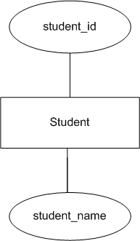
ER Diagram

Slide 20
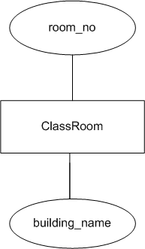
ER Diagram
Draw an ER Diagram for ClassRoom which has two attributes : room_no and building_name.

Slide 21
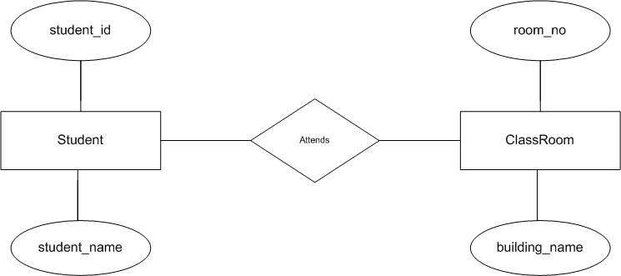
ER Diagram

Slide 22
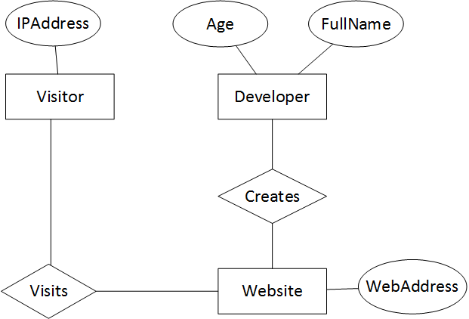
Task : Draw ER Diagram

Slide 23
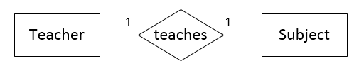
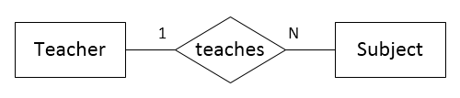
Multiplicity
A teacher teaches only one subject.
A teacher teaches many subjects.

Slide 24
Classification of Entity Sets (CHEN)
Entity sets can be broadly classified into:
Strong entity is one whose existence does not depend on other entity.
Strong entity
Weak entity is an entity that depends on another entity. Weak entity doesn't have key attribute of their own.
Weak entity
Associative entity is used to create many-to-many relationship between different entities
Associative or composite entity

Slide 25
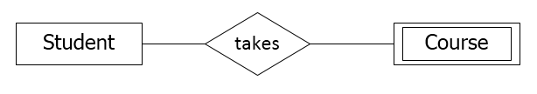
Classification of Entity Sets (CHEN)
Consider the example, student takes course. Here student is a strong entity.
Course is considered as weak entity because, if there are no students to take a particular course, then that course cannot be offered. The Course entity depends on the student entity.

Slide 26

Associative or Composite entity
The database relational model does not offer direct support to many- to-many relationships. So, we require associative or composite entity.
Consider the example, customer purchases book.
A customer can purchase many books. And a book can be purchased by many customers. So, here purchases is an associative entity. The entity purchases is mediator for customer and book.

Slide 27

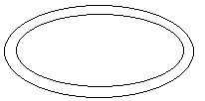
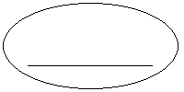
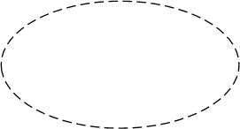
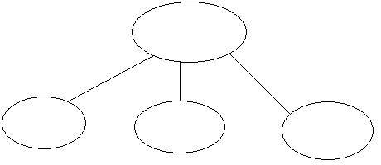
Attribute Notation (CHEN)
Single Valued Attribute
Multi-valued Attribute
Key Attribute
Derived Attribute
Composite Attribute

Slide 28

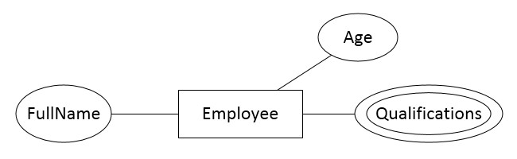
Multi-valued Attribute
An employee has first name, last name and can have more than one qualifications.

Slide 29
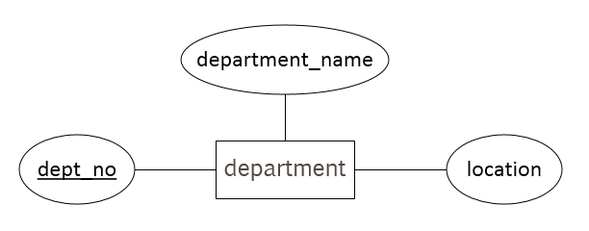
Key Attribute
Primary Key
A department has Primary Key dept_no, department_name and location

Slide 30
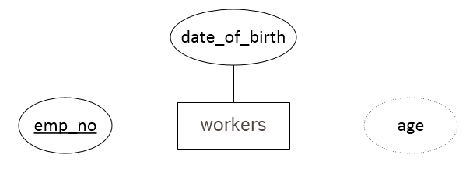
Derived Attribute
The value of the derived attribute can be derived from the values of other related attributes.
Age of a person can be derived from the date of birth and current date i.e. age = current date – date of birth. In this example, age is the derived attribute.

Slide 31
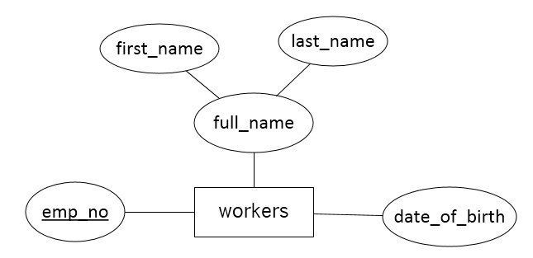
Composite Attribute
Composite attribute is one which can be further subdivided into simple attributes.

Slide 32
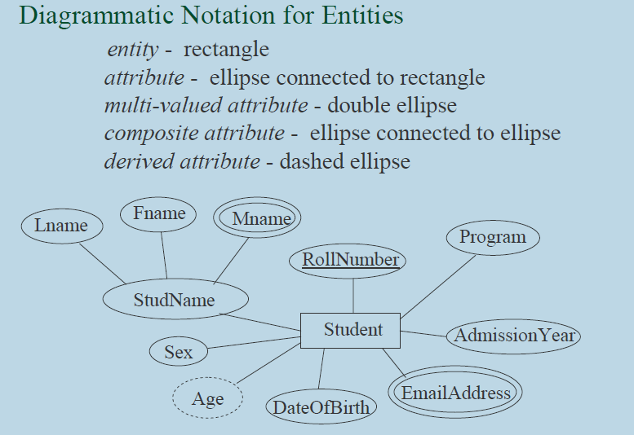
Entity- Relationship Model

Slide 33
Task : ER Diagram
Draw an ER diagram for student.
Draw an ER diagram for customers and loan relation.
Draw an ER diagram for hospital with a set of patients and medical doctors.
Draw an ER diagram for banking system.
Draw an ER diagram for car insurance company.

Slide 34
Relationship Degree
Relationship degree refers to the number of associated entities in a relationship.
The relationship degree can be broadly classified into
Unary(Recursive) relationship
Binary relationship
Ternary relationship

Slide 35
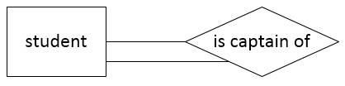
Unary(Recursive) relationship
The number of associated entity is one.
An entity related to itself is known as recursive relationship.

Slide 36

Binary relationship
In a binary relationship, two entities are involved.
Consider the example: each department will have many workers.

Slide 37
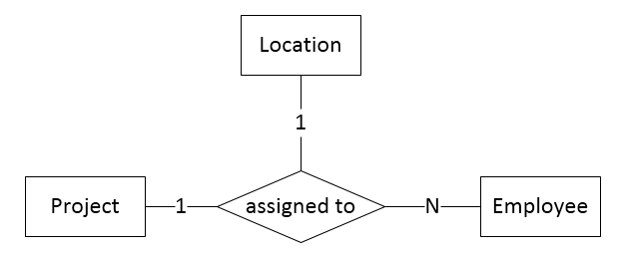
Ternary relationship
In a ternary relationship, three entities are simultaneously involved.
Example : Consider a project is assigned to many employee. And the project is assigned to one location.

